Slide 1

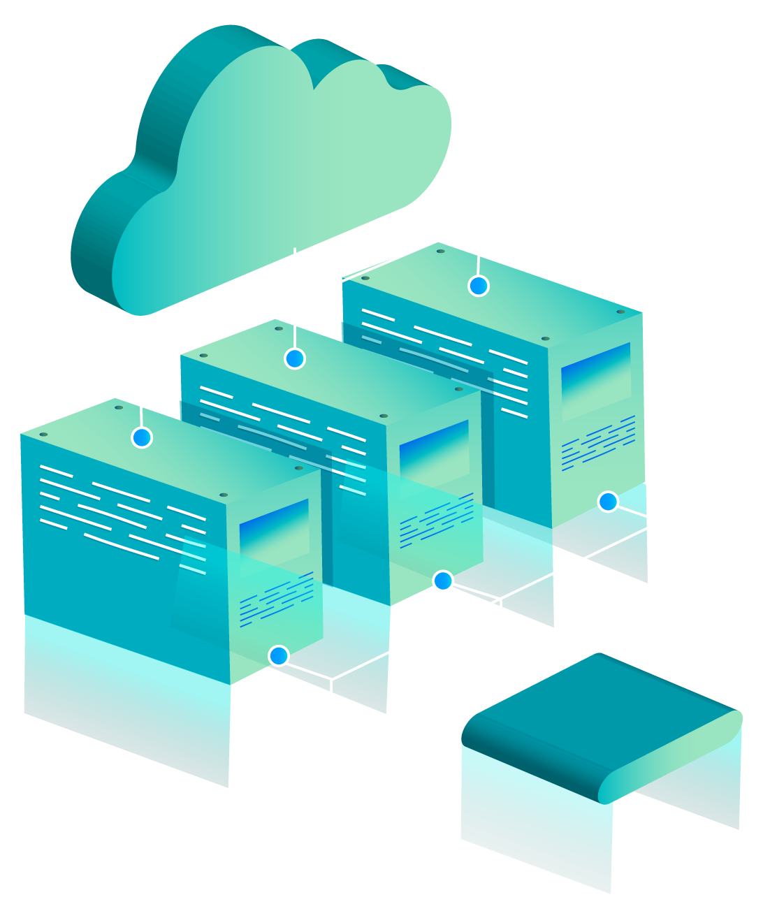
Cloud File Uploader
Course code : CSE363 : Cloud Computing
Instructor : DR. Ahmed Elmasry
Semester : Spring 25

Slide 2

INTRODUCTION
This project presents a cloud-based file uploader platform developed using Node.js, Docker, and MongoDB Replica Set.
It ensures high availability and data replication through a primary-secondary-arbiter setup.
The system allows user registration, authentication, file upload, storage, and access via a web interface.

Slide 3
Problem Statement
Need for reliable, available storage solutions in the cloud.
Ensuring data persistence, even if one database node fails.
Creating a responsive and user-friendly frontend for upload management.

Slide 4

Key Objectives
Design and deploy a file uploader with Dockerized Node.js.
Implement MongoDB replica set (Mongo1, Mongo2, Arbiter).
Provide shared storage across Node.js instances.
Enable user-specific file management with login, register, upload, view, and logout features.

Slide 5


Working Principle
User registers and a dedicated folder is created
User logs in, and a secure session is established.
File upload form appears—files are stored under their unique directory.
User can view/download files only from their folder.
Logout destroys the session and revokes access.

Slide 6
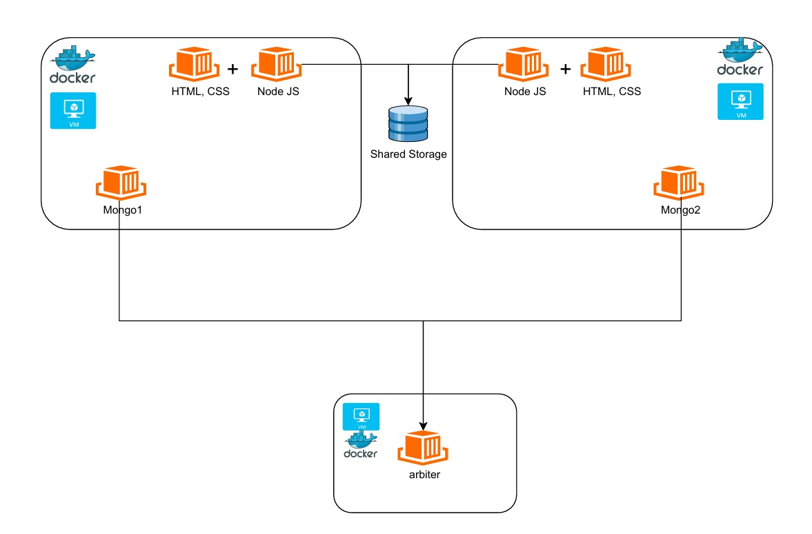
Architecture
Two VMs running Docker containers for MongoDB, Node.js, and frontend
Shared Storage between both servers
Arbiter container to handle replica election

Slide 7
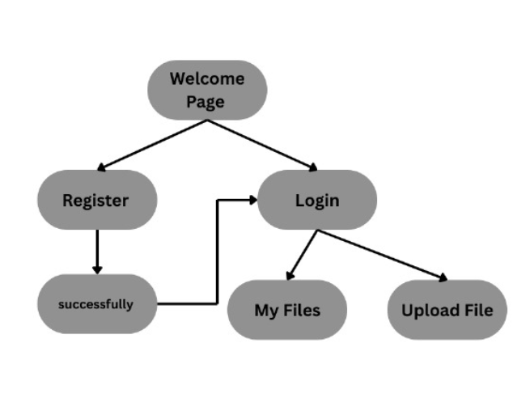
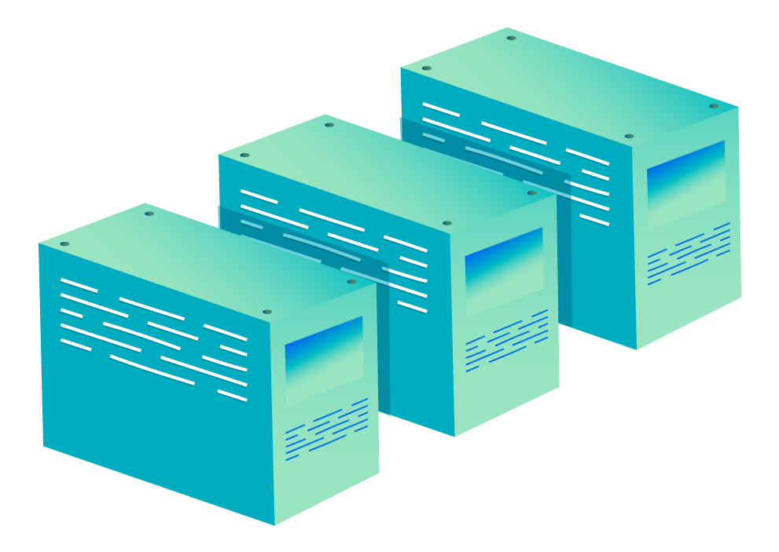
Front-End

Slide 8
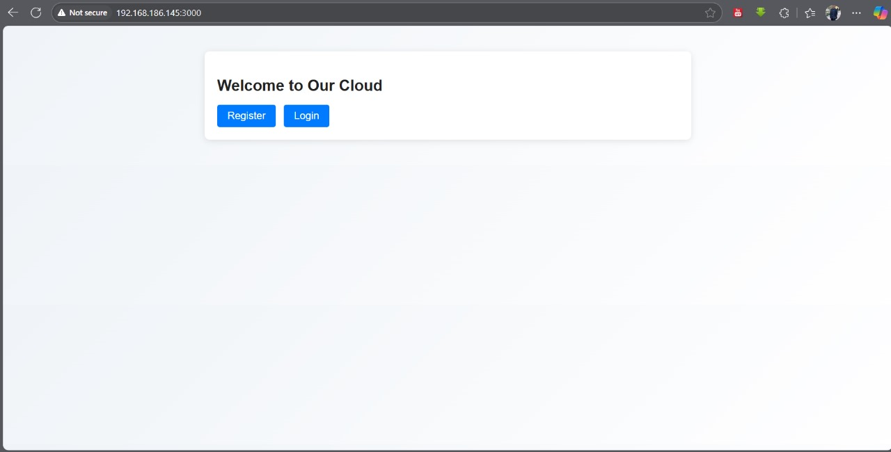
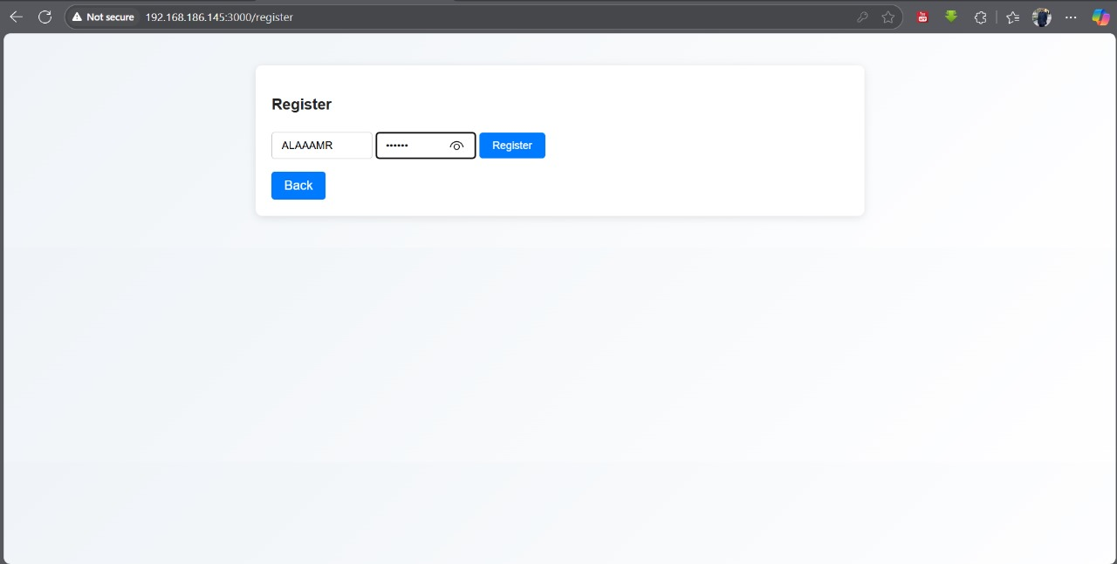
Frontend

Slide 9
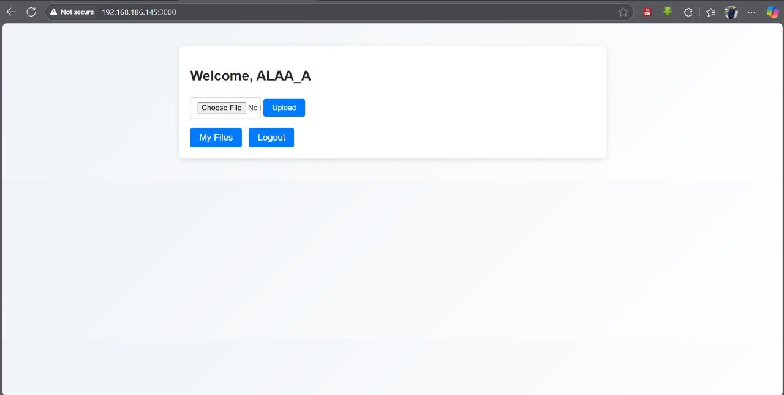
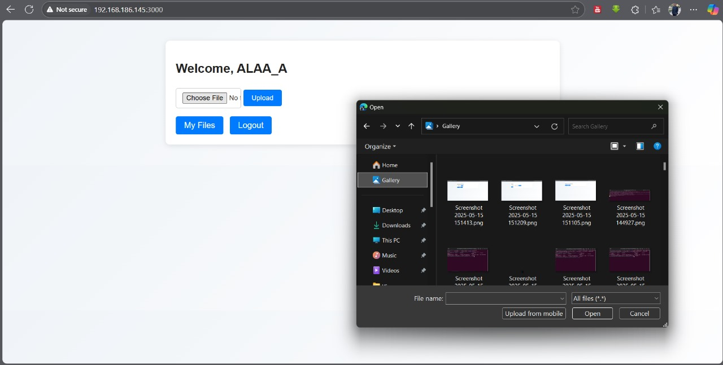
Frontend

Slide 10
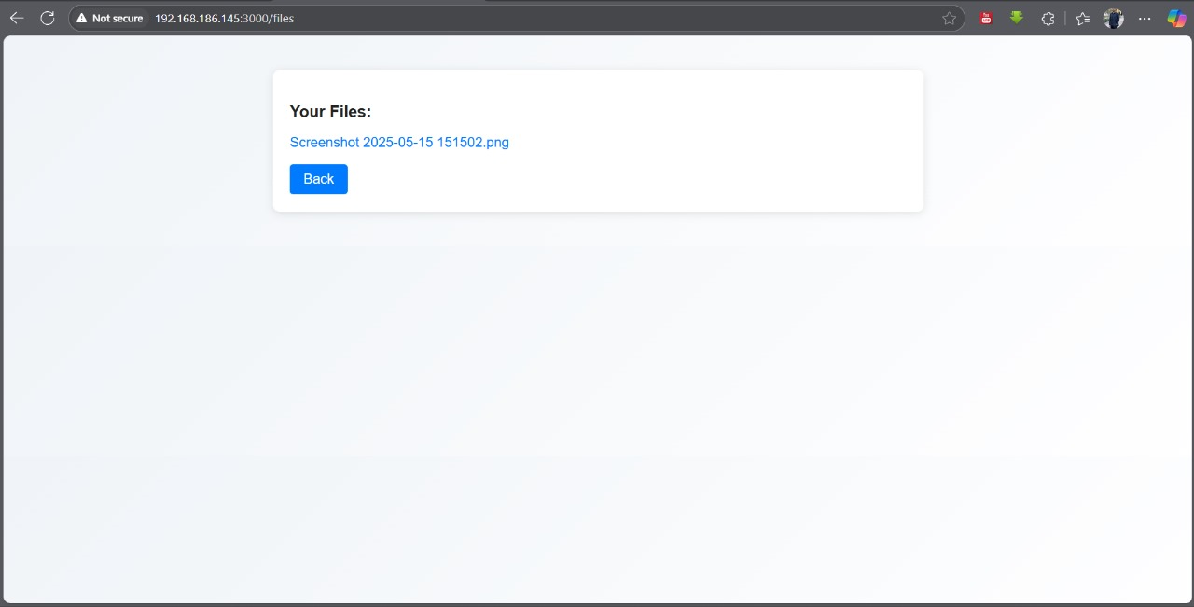
Frontend

Slide 11
Backend

Slide 12
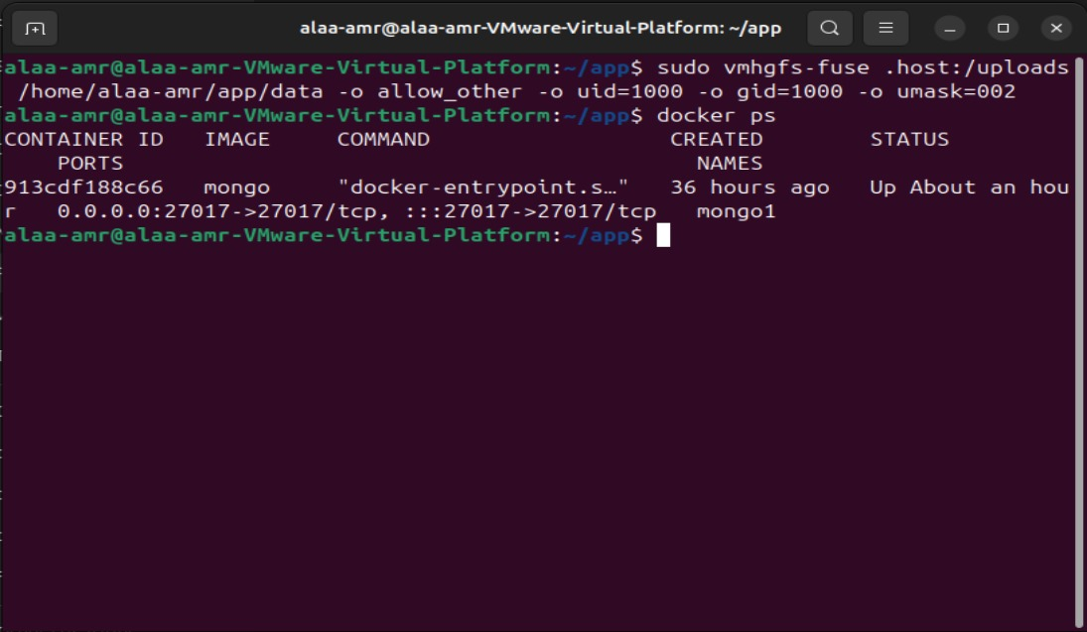
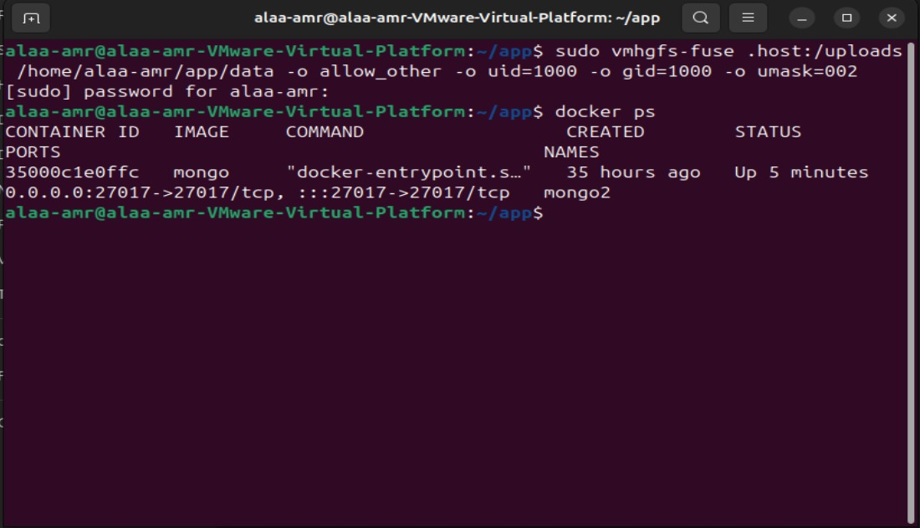
How To Run The Server
Mongo1
Mongo2

Slide 13
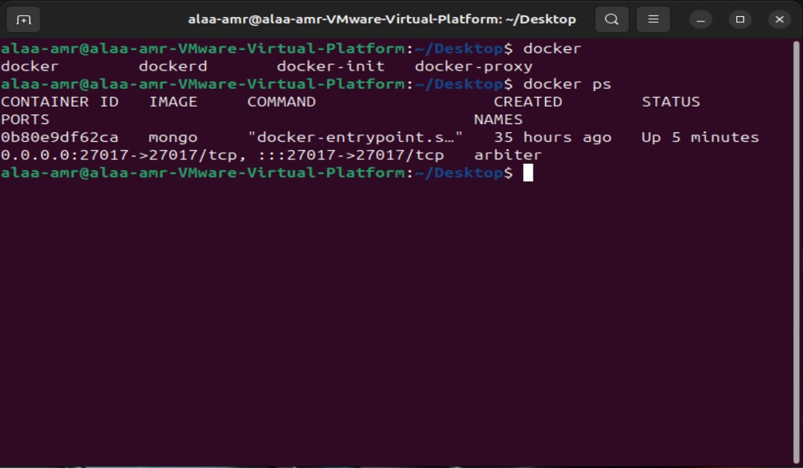
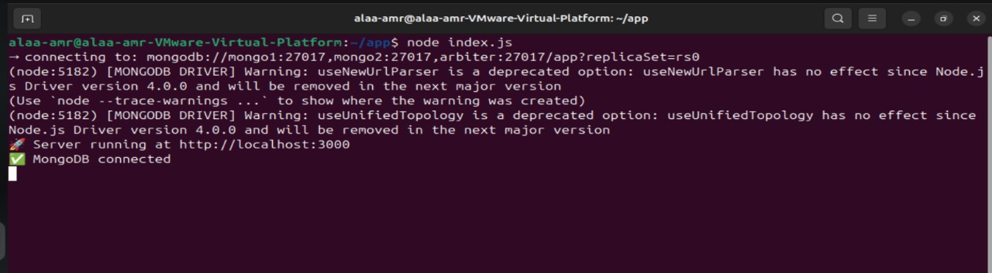
How To Run The Server
Arbiter
Running the Server

Slide 14

THANKS!
Team members :
Ahmed Hossam 221100101
Kareem Tarek 221101524
Mazen Hossam 221100514
Amro Khaled 221100199
Ahmed Samir 221101415
Ahmed Mohamed 221100116
(AIE)
Any questions ?

